Slide 1
Microbes in UC Davis
(Specifically outside the Katherine Esau Hall)
Created by Group 6 members:
Luis Alvarez
Alan Vongsavanh
Luis Barraza

Slide 2
Table of contents
01
02
03
Introducing the Project
Big Takeaways
App Showcase

Slide 3
01
Microbes In our Environment

Slide 4
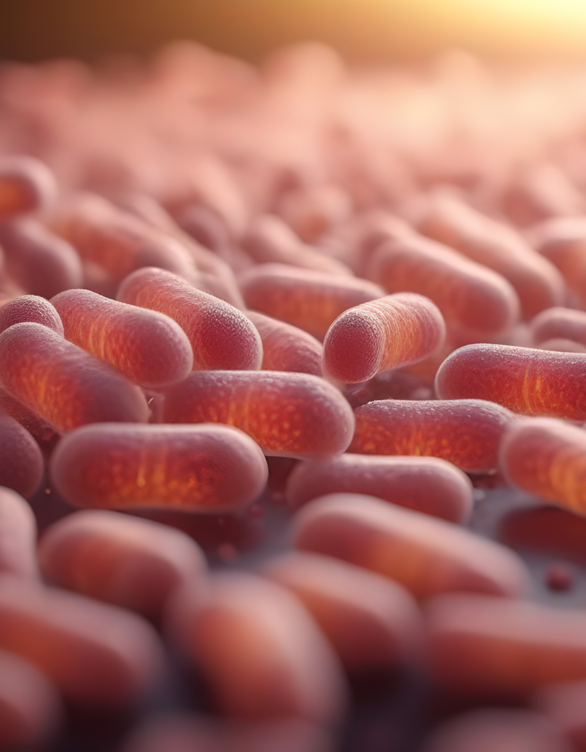
Experiment and Data provided by Dr. Markum’s MIC 104L Course
GERMS ARE EVERYWHERE
But which germs are really out there?
That is the question that we tried to answer over the years in the MIC 104L through the Microbes in the Environment Lab procedure.
I was lucky enough to not only participate in the experiment but also was lucky enough to get the previous 2 years worth of data,

Slide 5
Setup and Context
When?
The class is divided into multiple morning sections from 9am-11:50am and multiple afternoon sections from 1:10pm-4pm
What?
Each class section is filled with 24 students, each of which is provided with either 1 SDA + Ampicilin plate or 1 NA + Cycloheximide plate.
12 students are instructed to go outside and expose their plates to the air and 12 stay inside to expose their plates in the lab.
In either outside or inside groups, 4 students are exposing their plates for 1 minute, 4 for 10 minutes and 4 for 30 minutes.
Why?
SDA plates offer Dextrose sugar as the main carbon source with Ampicillin as the selective factor
NA plates offer Glucose sugar as the main carbon source with Cycloheximide as the selective factor

Slide 6
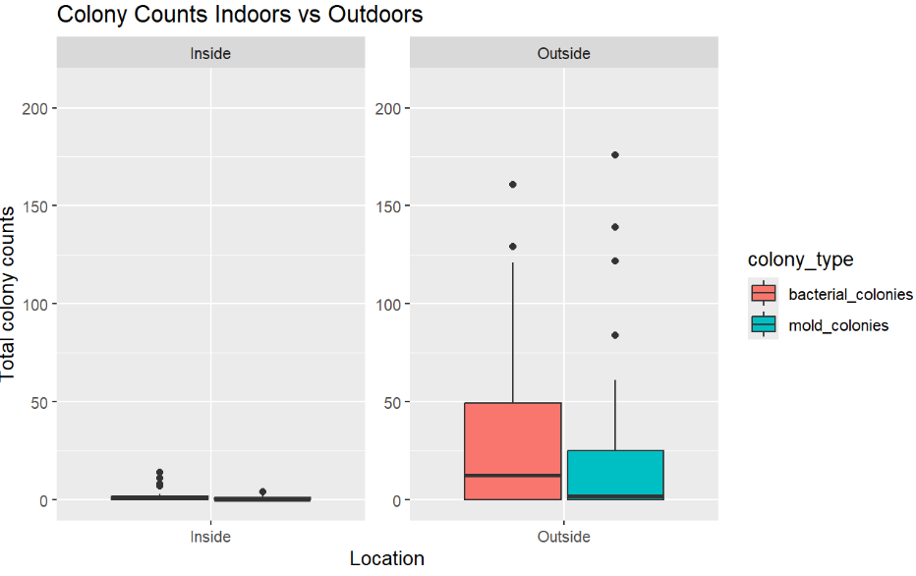
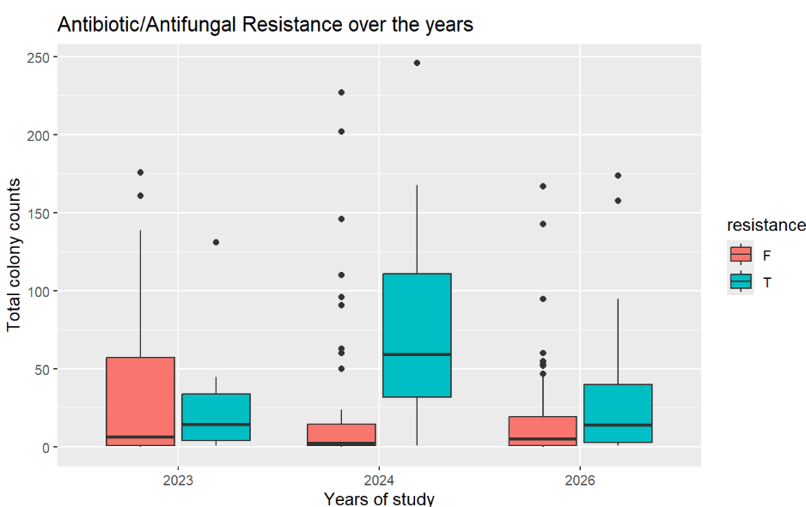
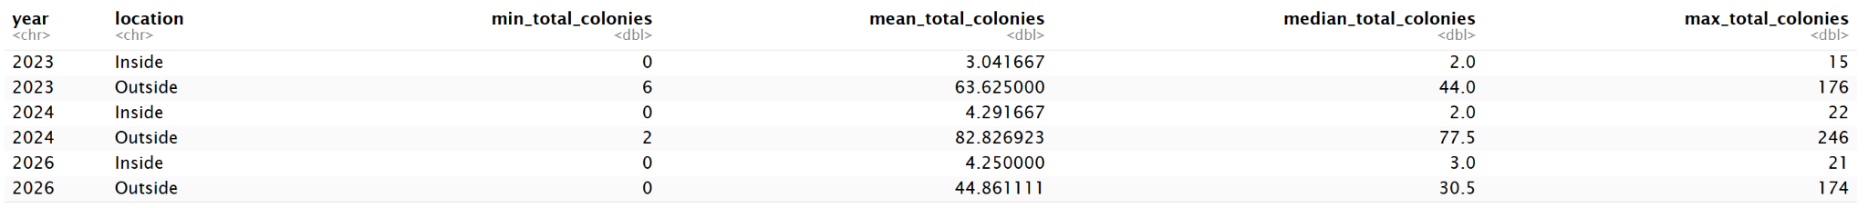
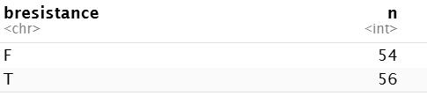
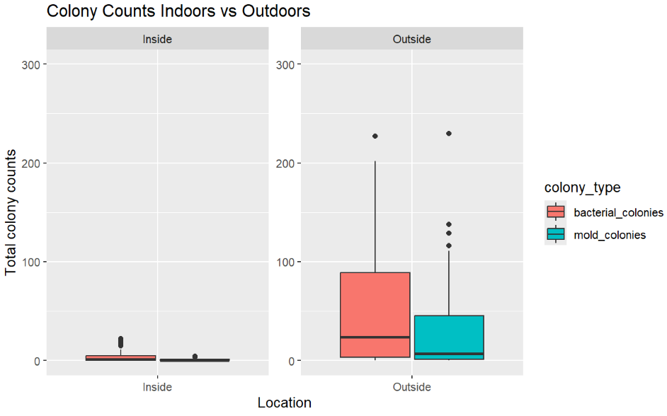
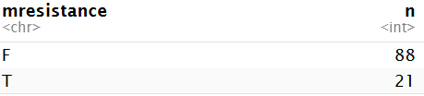
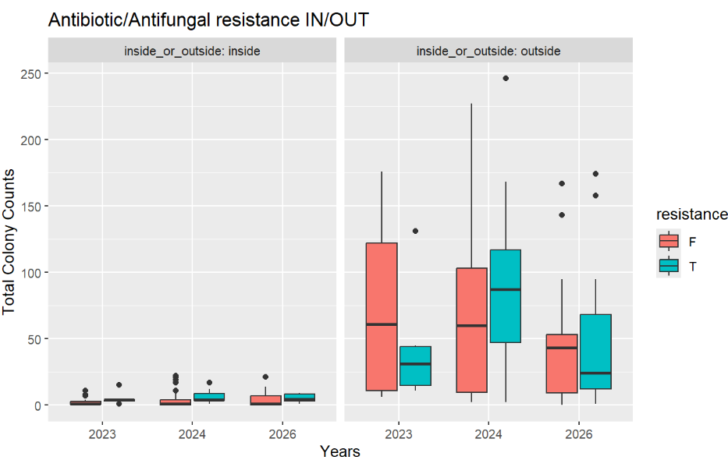
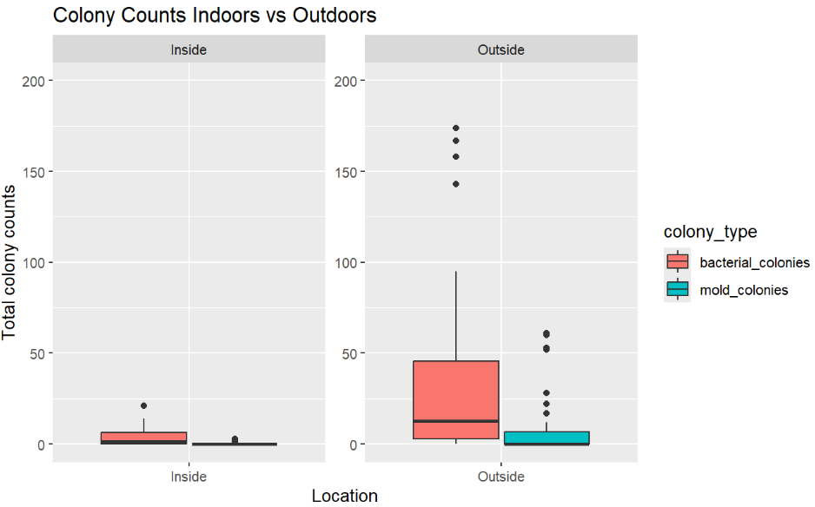
Big Takeaways
02
Prevalence
Resistance
2023
2024
2026

Slide 7
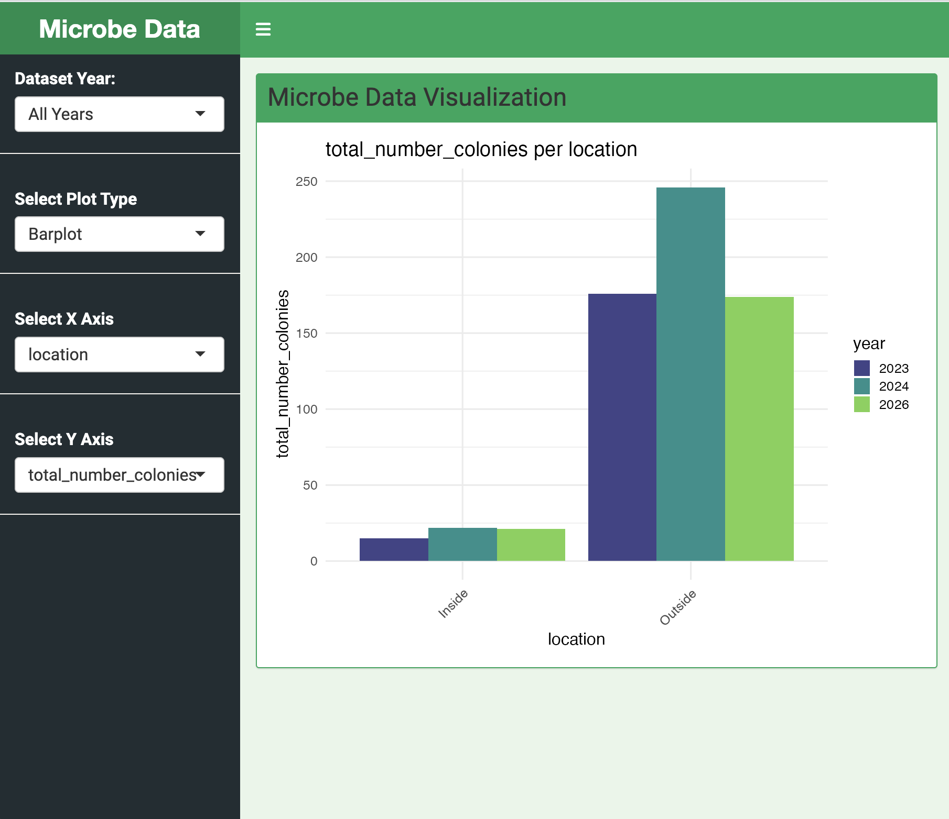
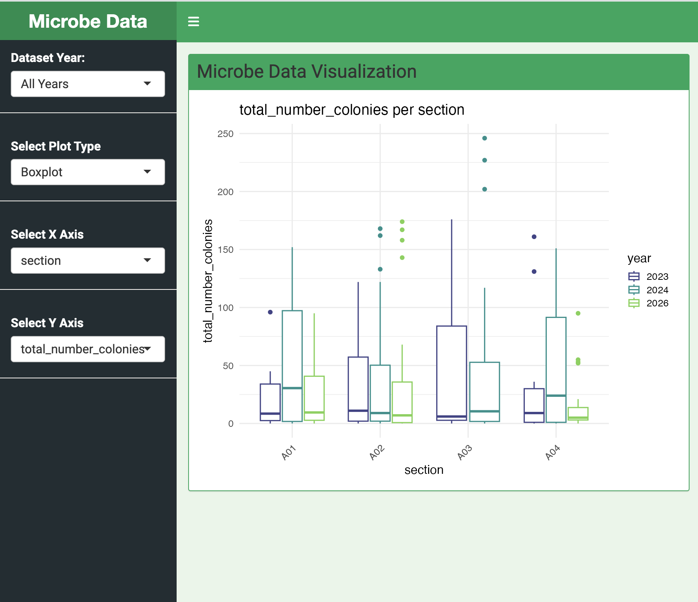
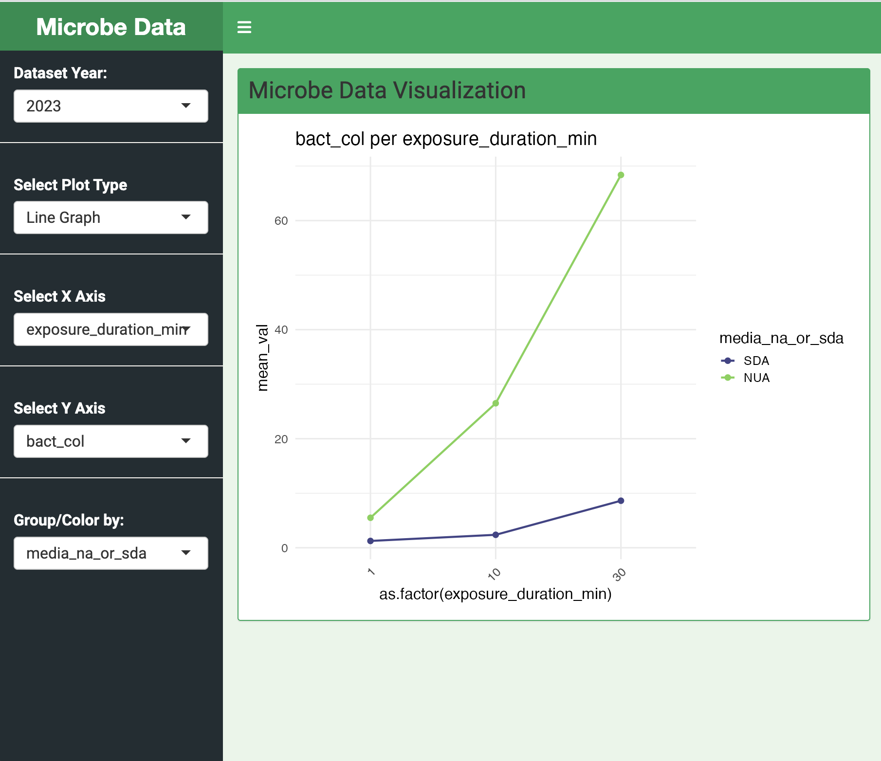
Our Shiny App demo

